Slide 1
Data Structures

Slide 2

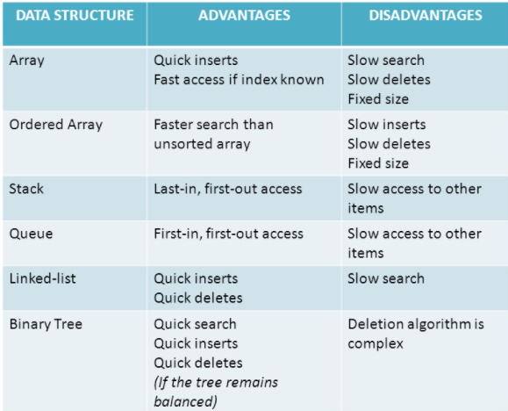
Characteristic of data structures

Slide 3

BINARY TREES
AND
BINARY SEARCH TREES

Slide 4
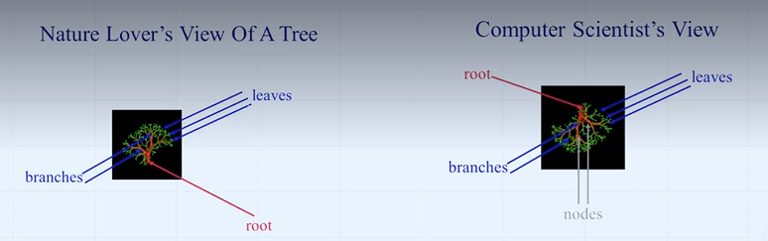
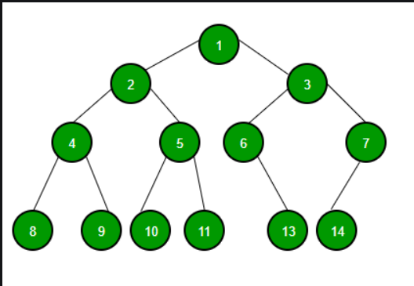
Trees representation
tree

Slide 5

Why tree data structure?
Other data structures such as arrays, linked list, stack, and queue are linear data structures that store data sequentially. In order to perform any operation in a linear data structure, the time complexity increases with the increase in the data size. But, it is not acceptable in today's computational world.
Different tree data structures allow quicker and easier access to the data as it is a non-linear data structure.
Tree is a hierarchical data structure which stores the information naturally in the form of hierarchy style.
Tree is one of the most powerful and advanced data structures.
A tree structure that you probably use every day is a file system. In a file system, directories, or folders, are structured as a tree.
Application of trees
XML Parser uses tree algorithms. Decision-based algorithm is used in machine learning which works upon the algorithm of tree. Databases also uses tree data structures for indexing. Domain Name Server(DNS) also uses tree structures.

Slide 6
Advantages of trees
The tree reflects the data structural connections.
The tree is used for hierarchy.
It offers an efficient search and insertion procedure.
The trees are flexible. This allows subtrees to be relocated with minimal effort.
Disadvantages of trees
A small change in the data can cause a large change in the structure of the decision tree causing instability.
Sequential storage may waste space (when it is not a complete binary tree), but it is more efficient when reading a specified node – O(0) – for binary trees(later will learn)
Chain storage wastes less space when compared to binary trees, but it is less efficient when reading a specified node. O(nlogn) - for binary trees (later will learn)

Slide 7
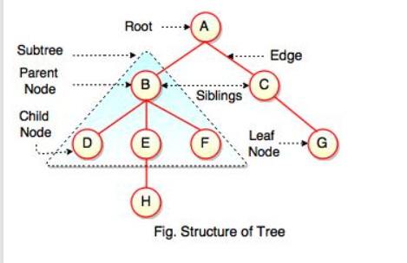
Terminologies of trees
D, F, H, G are leaves.
B and C are siblings.
A is a parent of B and C.
B is called a child of A and also parent of D, E, F.

Slide 8
Description
Path: A path is a sequence of edges between nodes.
Root: The root is the special node from which all other nodes "descend“. Each tree has a single root node.
Sibling: Nodes with the same parent are siblings.
Ancestor: An ancestor node of a node is any node in the path from that node to the root node (including the root node). The immediate ancestor of a node is the “parent” node.
Descendants: It is the inverse relationship of ancestors. A descendant node of a node is any node in the path from that node to the leaf node (including the leaf node). The immediate descendant of a node is the “child” node.
Leaves or External Nodes: The node which does not have a child.
Internal Nodes: Nodes which are not leaves, It have at least one child.
Subtree: The name emphasizes that everything which is a descendant of a tree node is a tree, too, and is a subset of the larger tree.
Level: Levels of a node represents the number of connections between the node and the root. It represents generation of a node. If the root node is at level 0, its next node is at level 1, its grand child is at level 2 and so on.
Height: The height of the tree is the level of the leaf in the longest path from the root plus 1. By definition the height of an empty tree is -1. Because the tree is drawn upside down, some texts refer to the depth of a tree rather than its height.

Slide 9
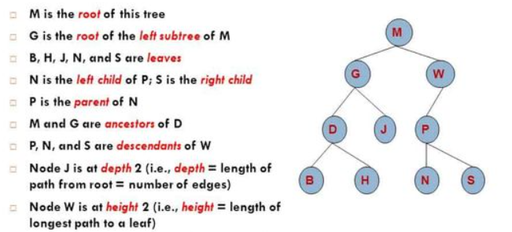
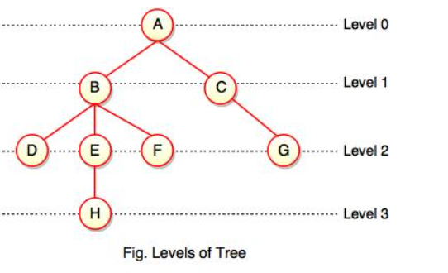
Example

Slide 10
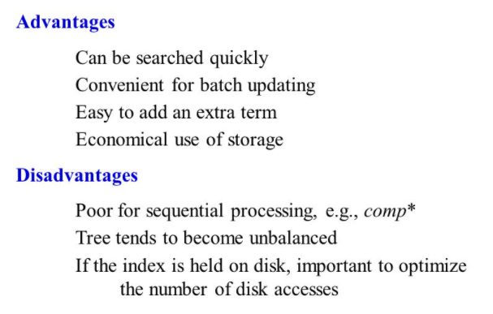
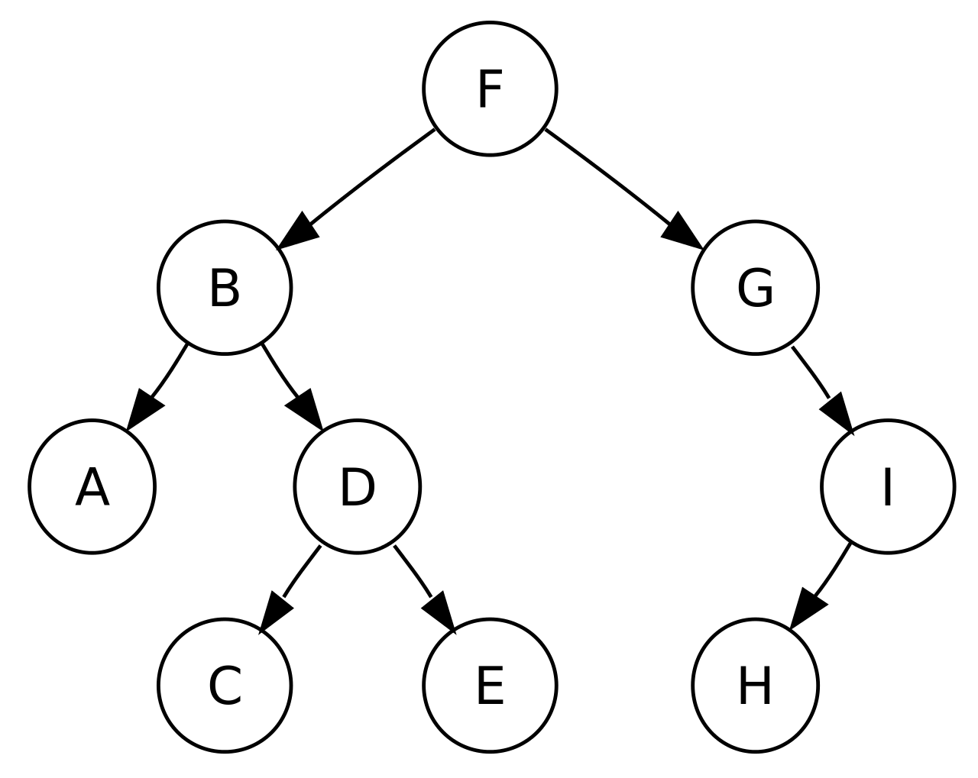
Binary tree
A binary tree is a hierarchical data structure in which each node has at most two children generally referred as left child and right child.
Each node contains three components: Pointer to left subtree, Pointer to right subtree, Data element.

Slide 11
Properties of binary tree
A binary tree can have a maximum 2^{l} nodes at level l if the level of root is zero. If the level of root is then 2^{l-1} . Here level is the number of nodes on path from root to the node, including the root itself.
A binary tree can have a maximum 2^{h}-1 nodes at height h if the height of a tree with a single node is considered as 1. It can be written as 2^(l+1)-1. (considered as height 1 and level as 0). If height 0 and level 0 then 2^(h+1)-1.
If there are n nodes in a binary search tree, maximum height of the binary search tree is n-1 and minimum height is floor(log2n).
If binary search tree has height h, minimum number of nodes is h+1, maximum number of nodes will be when all levels are completely full. Total number of nodes will be 2^0 + 2^1 + …. 2^h = 2^(h+1)-1.
In a binary tree with n nodes, minimum possible height or minimum number of levels are log₂(n+1). If we considered that the height of leaf node is considered as 0, then the formulae will be log₂(n+1)-1.
A Binary Tree with L leaves has at least | Log₂L? |+ 1 levels.
In Binary tree where every node has 0 or 2 children, the number of leaf nodes is always one more than nodes with two children.
No: of internal nodes is difference of no: of nodes and leaf nodes.

Slide 12
Questions:
The height of a tree is the length of the longest root-to-leaf path in it. The maximum and the minimum number of nodes in a binary tree of height 5 are: (A) 63 and 6, respectively (B) 64 and 5, respectively (C) 32 and 6, respectively (D) 31 and 5, respectively
Solution: According to formula discussed, max number of nodes = 2^(h+1)-1 = 2^6-1 =63. min number of nodes = h+1 = 5+1 = 6.
Which of the following height is not possible for a binary tree with 50 nodes? (A) 4 (B) 5 (C) 6 (D) None
Solution: According to formula discussed, Minimum height with 50 nodes = floor(log250) =5
Therefore height 4 is not possible.
In a full binary tree if number of internal nodes is I, then number of leaves L are? a) L = 2*I b) L = I + 1 c) L = I – 1 d) L = 2*I – 1
Answer: b Explanation: Number of Leaf nodes in full binary tree equal to
1 + Number of Internal Nodes L=I+1
In a full binary tree if number of internal nodes is I, then number of nodes N are? a) N = 2*I b) N = I + 1 c) N = I – 1 d) N = 2*I + 1
Answer: d Explanation: Relation between number of internal
nodes(I) and nodes(N) is N = 2*I+1.
In a full binary tree if there are L leaves, then total number of nodes N are? a) N = 2*L b) N = L + 1 c) N = L – 1 d) N = 2*L – 1
Answer: d Explanation: The relation between number of
nodes(N) and leaves(L) is N=2*L-1.

Slide 13
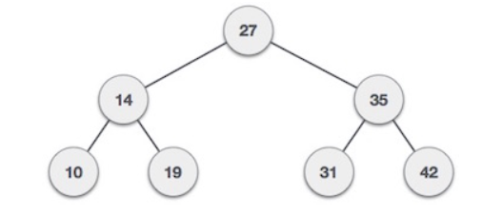
Node declaration
class Node {
int key;
Node left;
Node right;
Node(int k) {
key = k;
left = right = null;
}
}
Input
Node root = new Node(27);
root.left = new Node(14);
root.right = new Node(35);
root.right.right = new Node(42);
root.right.left = new Node(31);
root.left.left = new Node(10);
root.left.right = new Node(19);
System.out.println(height(root));
Height of tree
static int height(Node root) {
if (root == null)
return 0;
else
return (Math.max(height(root.right), height(root.left)) + 1);
}

Slide 14
Traversals of tree
Traversal is a process to visit all the nodes of a tree and may print their values too. Because, all nodes are connected via edges (links) we always start from the root (head) node. That is, we cannot randomly access a node in a tree. There are three ways which we use to traverse a tree
1. In-order traversal
2. Pre-order traversal
3. Post-order traversal
Generally, we traverse a tree to search or locate a given item or key in the tree or to print all the values it contains.

Slide 15
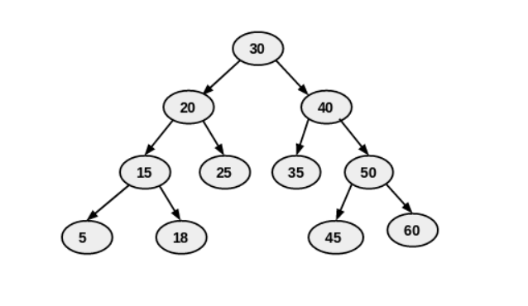
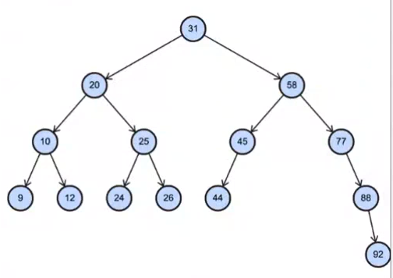
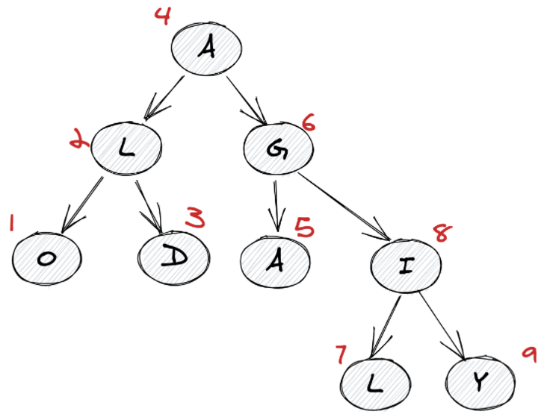
In-order traversal
In this traversal method, the left subtree is visited first, then the root and later the right sub-tree. We should always remember that every node may represent a subtree itself. (left-root-right)
OUTPUT -> 5 , 15 , 18 , 20 , 25 , 30 , 35 , 40 , 45 , 50 , 60
OUTPUT -> 9 , 10 , 12 , 20 , 24 , 25 , 26 , 31 , 44 , 45 , 58 , 77 , 88 , 92

Slide 16
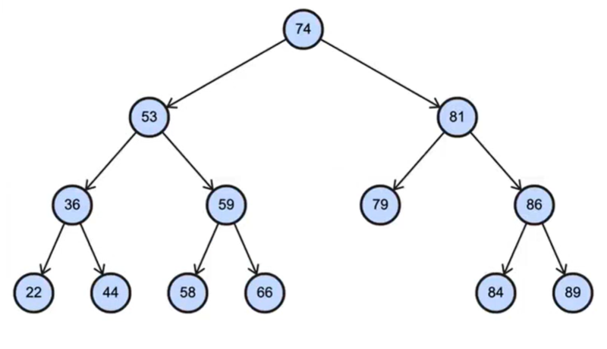
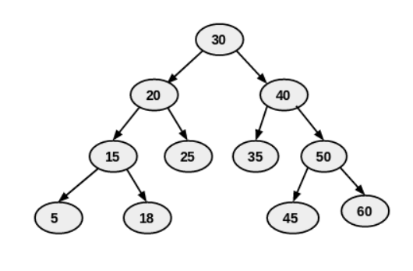
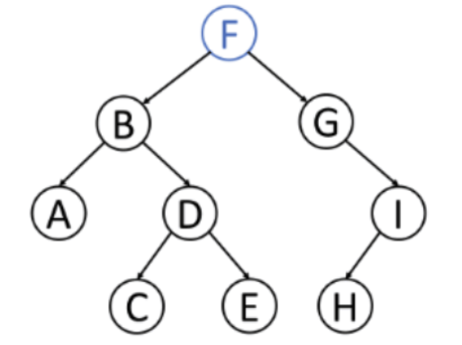
Pre-order traversals
In Preorder traversal we traverse from root-left-right. In this traversal root visited first then the left subtree and later the right subtree. Remember that every node may represent a subtree itself.
1
2
7
3
4
8
OUTPUT -> 30 , 20 , 15 , 5 , 18 , 25 , 40 , 35 , 50 , 45 , 60
OUTPUT -> 74 , 53 , 36 , 22 , 44 , 59 , 58 , 66 , 81 , 79 , 86 , 84 , 89
5
6
9

Slide 17
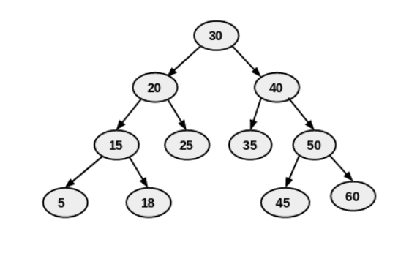
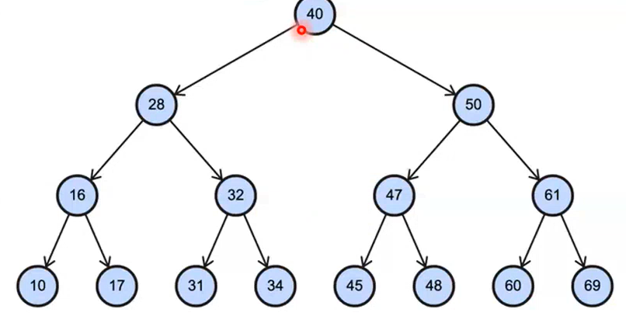
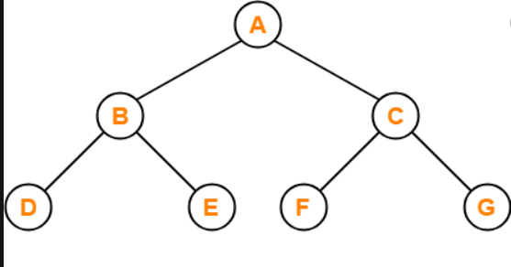
Post-order traversals
In Preorder traversal we traverse from left-right-root. In this traversal left subtree visited first then the right subtree and later the root. Remember that every node may represent a subtree itself.
7
6
3
OUTPUT -> 5 , 18 , 15 , 25 , 20 , 35 , 45 , 60 ,50 , 40 , 30
OUTPUT -> 10 , 17 , 16 , 31 , 34 , 32 , 28 , 45 , 48 , 47 , 60 , 69 , 61 , 50 , 40
1
2
4
5

Slide 18
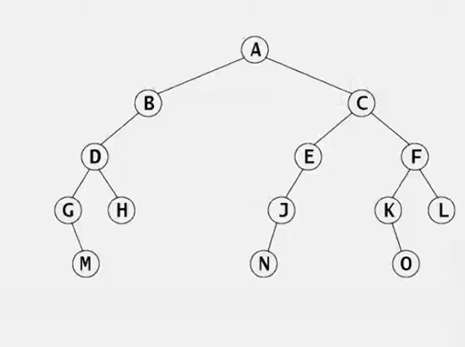
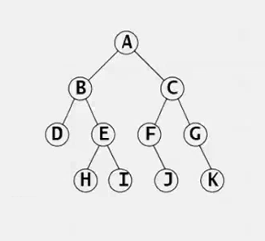
OUTPUT
In-order: G M D H B A N J E C K O F L
Pre-order: A B D G M H C E J N F K O L
Post-order: M G H D B N J E O K L F C A
OUTPUT
In-order: D B H E I A F J C G K
Pre-order: A B D E H I C F J G K
Post-order: D H I E B J F K G C A

Slide 19
Codes for traversals
In-order
static void inorder(Node root) {
if (root != null) {
inorder(root.left);
System.out.print(root.key + " ");
inorder(root.right);
}
}
Pre-order
static void preorder(Node root) {
if (root != null) {
System.out.print(root.key + " “);
preorder(root.left);
preorder(root.right);
}
}
Post-order
static void postorder(Node root) {
if (root != null) {
postorder(root.left);
postorder(root.right);
System.out.print(root.key + " ");
}
}

Slide 20
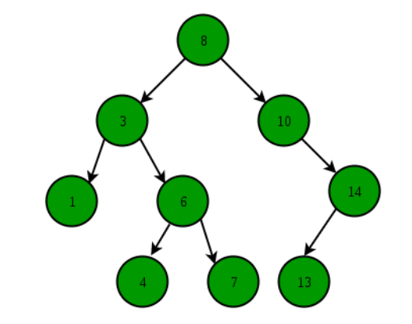
Binary Search tree
The left subtree of a node contains only nodes with keys lesser than the node’s key.
The right subtree of a node contains only nodes with keys greater than the node’s key.
The left and right subtree each must also be a binary search tree.

Slide 21
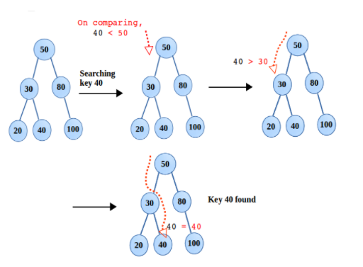
Code for search in binary tree
Recursive
Iterative
static boolean search(Node root, int key) {
if (root == null)
return false;
else if (root.key == key)
return true;
else if (root.key > key)
return search(root.left, key);
else
return search(root.right, key);
}
static boolean searchbetter(Node root, int key) {
while (root != null) {
if (root.key == key)
return true;
else if (root.key > key)
root = root.left;
else
root = root.right;
}
return false;
}

Slide 22
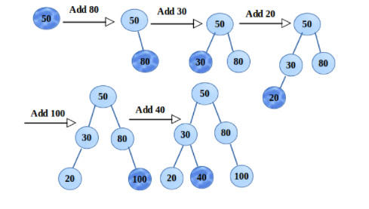
Insertion
Recursive
Iterative
public static Node insertbetter(Node root, int x) {
Node temp = new Node(x);
Node parent = null, curr = root;
while (curr != null) {
parent = curr;
if (curr.key > x)
curr = curr.left;
else if (curr.key < x)
curr = curr.right;
else
return root;
}
if (parent == null)
return temp;
if (parent.key > x)
parent.left = temp;
else
parent.right = temp;
return root;
}
static Node insert(Node root, int key) {
Node temp = new Node(key);
if (root == null)
return temp;
else if (root.key > key)
root.left = insert(root.left, key);
else if (root.key < key)
root.right = insert(root.right, key);
return root;
}

Slide 23
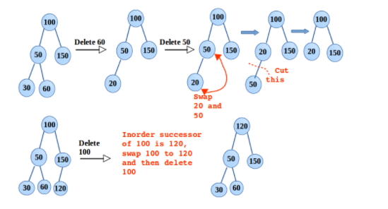
Deletion
static Node delete(Node root, int key) {
if (root == null)
return null;
if (root.key > key)
root.left = delete(root.left, key);
else if (root.key < key)
root.right = delete(root.right, key);
else {
if (root.right == null)
return root.left;
else if (root.left == null)
return root.right;
else {
Node sucess = getsuccessor(root);
root.key = sucess.key;
root.right = delete(root.right, sucess.key);
}
}
return root;
}
static Node getsuccessor(Node root) {
Node curr = root.right;
while (curr != null && curr.left != null)
curr = curr.left;
return curr;
}

Slide 24
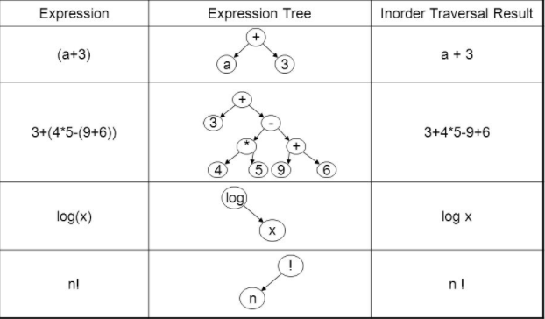
Expression tree
An expression tree is a representation of expressions arranged in a tree-like data structure. In other words, it is a tree with leaves as operands of the expression and nodes contain the operators.
An arithmetic expression such as (5*x)*y+6/(x+z) is a combination of arithmetic operators (+, *, /, etc.), operands (5,x,y,6,z,etc.), and parentheses to override the precedence of operations. Each expression can be represented by a unique binary tree whose structure is determined by the precedence of operations in the expression. Such a tree is called an expression tree.
Examples of expression tree :

Slide 25
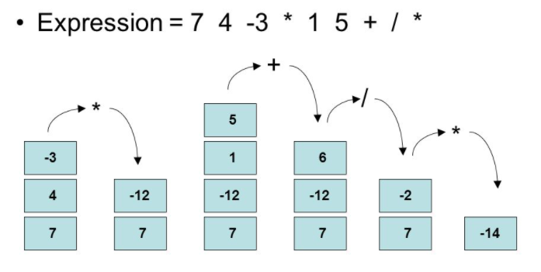
Evaluation of postfix expression
Following is algorithm for evaluation postfix expressions. 1) Create a stack to store operands (or values). 2) Scan the given expression and do following for every scanned element. …..a) If the element is a number, push it into the stack …..b) If the element is a operator, pop operands for the operator from stack. Evaluate the operator and push the result back to the stack 3) When the expression is ended, the number in the stack is the final answer.
4) This process also similar to prefix expression

Slide 26
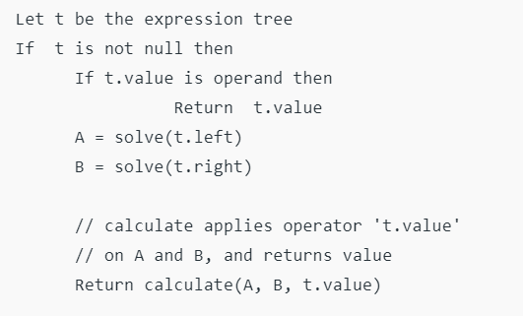
Code for expression of tree
For constructing an expression tree we use a stack. We loop through input expression and do the following for every character.
If a character is an operand push that into the stack
If a character is an operator pop two values from the stack make them its child and push the current node again.
In the end, the only element of the stack will be the root of an expression tree.

Slide 27
code
public class expressiontree {
public static void main(String[] args) {
String postfix = "ab+ef*g*-";
char[] charArray = postfix.toCharArray();
Node root = constructtree(charArray);
inorder(root);
}
class Node {
char value;
Node left, right;
Node(char d) {
value = d;
left = right = null;
}
}
static boolean isoperator(char c) {
if (c == '+' || c == '-' || c == '*' || c == '/' || c == '^')
return true;
return false;
}
static Node constructtree(char postfix[]) {
Stack<Node> sai = new Stack<Node>();
Node t, t1, t2;
for (int i = 0; i < postfix.length; i++) {
if (!isoperator(postfix[i])) {
t = new Node(postfix[i]);
sai.push(t);
} else {
t = new Node(postfix[i]);
t1 = sai.pop();
t2 = sai.pop();
t.right = t1;
t.left = t2;
sai.push(t);
}
}
t = sai.peek();
sai.pop();
return t;
}

Slide 28




















































Slide 29

































Slide 30


























Slide 31























Slide 32



























